Slide 1

STAKEHOLDER BRIEFING · UNIVERSAL KERNEL
DECLARED CLAIM
Sovereign Engine: A Theory-Agnostic Universal Kernel
NAMED CHECK
A common evidence layer below theories—built to compare declared structures fairly, verify named checks precisely, and preserve uncertainty honestly.
INSPECTABLE RECEIPT
FRAMEWORK LABELS ARE PROVENANCE, NOT ONTOLOGY

Slide 2

PRODUCT CORRECTION
The correction changes the product.
RISK TO AVOID
KERNEL ROLE
A local check quietly becomes an implied theory or worldview.
A framework label is provenance, never evaluator semantics.
A framework name can create accidental authority: the user sees a passing result and assumes the whole framework has been validated.
The kernel evaluates only a declared object and named predicate. A receipt supports that narrow statement—and no broader scientific, interpretive, or metaphysical conclusion.
KEEP RESEARCH DIVERSE · KEEP EVALUATION EXPLICIT · KEEP NON-CLAIMS VISIBLE

Slide 3

UNIVERSAL ADAPTER CONTRACT
Claims enter as explicit packets.
The kernel can only assess what the packet makes visible.
{ "schema": "sov.structural_claim_packet", "framework_id": "framework:example", "claim_id": "claim:matrix-symmetry", "claim_class": "structural", "check": "matrix.symmetric.v1", "input": [[1, 2], [2, 4]], "assumptions": ["exact finite equality"], "source_refs": ["declared provenance"] }
Framework ID tells us where a claim came from. It does not choose a special evaluator. Claim class prevents empirical, interpretive, or metaphysical statements from being forced into a structural verdict.
RED = PROVENANCE ONLY · THE CHECK AND INPUT DETERMINE THE RECEIPT

Slide 4

COMPARATIVE ADAPTER EVIDENCE · 7 FRAMEWORK LABELS
Same structure. Same receipt.
The adapter reads framework labels as provenance only; the named check and declared input determine the result.
PROVENANCE LABELS SUBMITTED
SHARED STRUCTURAL CLAIM
framework:geometric-unity
ONE IDENTICAL OUTCOME
A = [ 1 2 ] [ 2 4 ]
framework:causal-set
Verified
framework:exceptional-algebra
sov:sha256:38b2c892520739e9e602202e2b8a3e78ff4f8ba80b2159d1bf09f0539d07fbd8
matrix.symmetric.v1
framework:amplitudes-twistor
framework:noncommutative-geometry
This demonstrates implementation neutrality for one declared check. It does not establish that the frameworks are equivalent.
framework:holographic-qec
framework:custom-research
RESULT: THE SAME INPUT PRODUCED THE SAME RECEIPT ID UNDER ALL SEVEN LABELS.

Slide 5

RECEIPT MODEL
Three honest outcomes.
Every result is local to the declared check, input, and stated assumptions.
VERIFIED
FAIL
UNVERIFIABLE
Holds in this check
Does not hold in this check
Cannot be checked here
The named predicate held for the declared structure. The receipt records exactly what was checked and its scope.
The input, representation, or evidence process is not sufficient. The kernel does not guess or disguise uncertainty.
The input was sufficient, and a mismatch or violation was found. The receipt identifies where it occurred.
None of these outcomes proves—or disproves—an entire scientific framework, interpretation, or theory of reality.
LOCAL RESULT · EXPLICIT SCOPE · NO THEORY-LEVEL PROMOTION

Slide 6
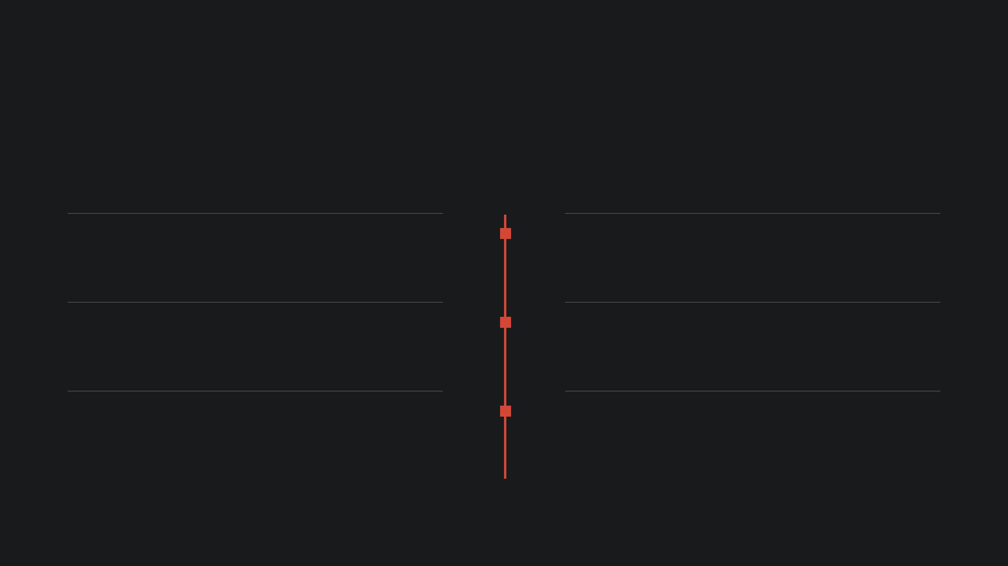
CURRENT UNIVERSAL ADAPTER PORTFOLIO
The portfolio is growing carefully.
Each capability is a bounded object plus a named predicate, fixtures, replay path, scope, and non-claim—not a shortcut to a framework-level conclusion.
MATRIX.SYMMETRIC.V1
MATRIX.IDENTITY.V1
Matrix symmetry
Identity structure
Exact equality to transpose
Diagonal one, off-diagonal zero
MATRIX.INVERSE.V1
RELATION.PARTIAL_ORDER.V1
Declared inverse
Finite partial order
Finite product equals identity
Reflexive, antisymmetric, transitive
GRAPH.UNDIRECTED_CONNECTED.V1
TENSOR.RANK3_LAST_INDICES_SYMMETRIC.V1
Graph connectivity
Tensor index symmetry
Reachability in a simple undirected graph
Exact final-index component symmetry
ADMISSION RULE: explicit object · predicate · assumptions · positive/negative/malformed fixtures · receipt scope · replay · audit · non-claims

Slide 7

PROGRESSIVE ASSURANCE · OPTIONAL DEPTH
Assurance is optional and inspectable.
Every user can read the result. Advanced users can independently retrace the evidence—one bounded layer at a time.
05 · FIXTURE CRYPTO
04 · INCLUSION
Offline Ed25519
03 · LOCAL RECORD
Merkle proof
A deterministic test vector is checked against an active policy-listed key.
02 · REPLAY
Audit attachment
The recorded event is checked against its local checkpoint root.
01 · EVERYDAY
Receipt provenance
Persisted local bundle, event, and checkpoint artifacts.
Readable receipt
What was checked, why it held or failed, and the scope.
Declared input and named check reproduce the same receipt ID.
ABSENT EVIDENCE IS NEVER TREATED AS TRUST · EACH LAYER STATES ITS OWN SCOPE
LOCAL EVIDENCE ≠ PUBLIC LOG OR PRODUCTION CONSENSUS

Slide 8

ARCHIVAL CONTEXT POLICY
Research is preserved, not privileged.
Theory-specific documents remain valuable provenance. They do not define evaluator semantics or turn a local receipt into a theory-level verdict.
ARCHIVAL RESEARCH
ACTIVE KERNEL
Keep the source trail intact.
Only bounded claims cross the boundary.
Historical transcripts, meaning-layer notes, research comparisons, and prior decks are indexed rather than erased.
EXPLICIT ADMISSION BOUNDARY
A future adapter must name its object, predicate, assumptions, fixtures, receipt scope, replay behavior, audit behavior, and non-claims. A framework name remains provenance only.
Shows where a claim originated
Preserves competing ideas and assumptions
Supports future adapter proposals
No source text, tradition, or theory label can silently become active kernel ontology.
47 THEORY-SPECIFIC HISTORICAL RECORDS INDEXED AS ARCHIVAL CONTEXT · ACTIVE POLICY: THEORY-AGNOSTIC UNIVERSAL KERNEL

Slide 9

UNIVERSAL ADAPTER PORTFOLIO · NEXT GATES
One admission rule for every adapter.
The roadmap expands what can be checked without choosing what theory should win.
U2
U3
U4
U5
Graph invariant
Tensor relation
Empirical descriptor
Formal bridge
A finite graph predicate with fixed fixtures, replay, and mutation evidence.
A finite indexed-tensor predicate with explicit dimensions and conventions.
A packet for provenance, uncertainty, protocol, and external statistical process.
A theorem/source/assumption binding to a named code predicate.
NON-CLAIM: no network or emergent-spacetime ontology.
NON-CLAIM: no physical field-theory validation.
NON-CLAIM: data alone is not theory proof.
NON-CLAIM: no proof of an entire runtime or framework.
THE SINGLE ADMISSION RULE
Object · predicate · assumptions · fixtures · receipt scope · replay · audit · non-claims
FRAMEWORK NAMES MAY ENTER AS PROVENANCE · THEY MAY NOT ENTER AS HIDDEN EVALUATION PRIVILEGE

Slide 10
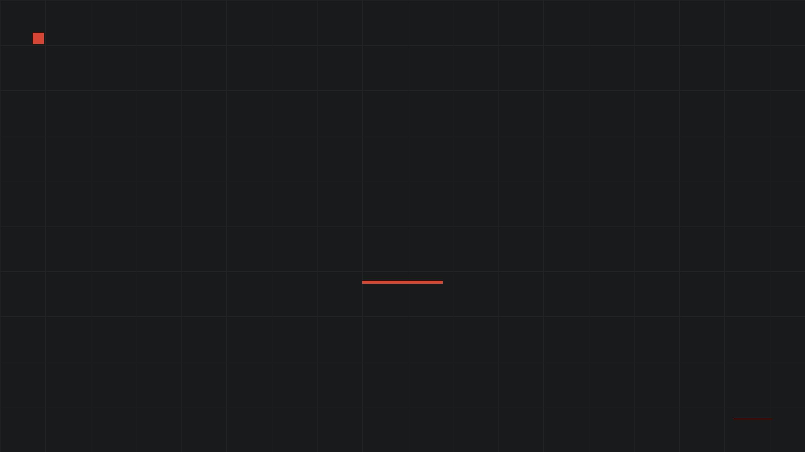
SOVEREIGN ENGINE · THEORY-AGNOSTIC EVIDENCE LAYER
Compare claims fairly. Verify structures precisely. Preserve uncertainty honestly.
A common, inspectable foundation below theories—without asking any one theory to become the kernel’s ontology.
DECLARED CLAIM · NAMED CHECK · REPLAYABLE RECEIPT · EXPLICIT NON-CLAIM

